Slide 1
Angular Day5
Presented By: Asmaa Ahmed

Slide 2
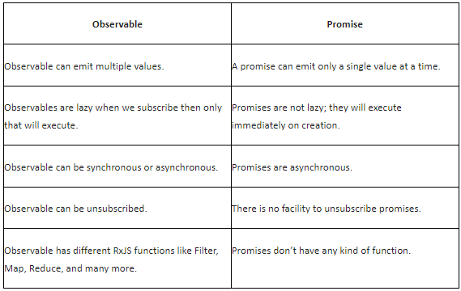
Difference Between Observable and Promise

Slide 3
To understand the HTTP code, it's important to understand Reactive Extensions and Observables

Slide 4

Reactive Extensions (RxJS)
A library for composing data using observable sequences
And transforming that data using operators
Similar to .NET LINQ operators
Angular uses Reactive Extensions for working with data
Especially asynchronous data

Slide 5


Synchronous vs. Asynchronous
Synchronous: real time
Asynchronous: No immediate response
HTTP requests are asynchronous: request and response

Slide 6



Web Browser
Web Server
index.html
index.html
JavaScript
JavaScript
http://mysite/api/products/5
Web
Service
Response
Da_{D}t_{B}a

Slide 7
Getting Data
Application
Get me products
Web Server
Get me a list of products
Notify me when the response arrives
I'll continue along
At some later point in time…
Application
Here are the products
Web Server
"Hey, your data arrived"
OK, I'll process it. Thanks!

Slide 8
Observable
A collection of items over time
Unlike an array, it doesn't retain items
Emitted items can be observed over time
Array: [ A, P, P, L, E ]
Observable:
A P P L E

Slide 9




What Does an Observable Do?
Nothing until we subscribe
next: Next item is emitted
error: An error occurred and no more items are emitted
complete: No more items are emitted

Slide 10
Getting Data
Application
Get me products
Web Server
Call http get
http get returns an Observable, which will emit notifications
Subscribe to start the Observable and
the get request is sent
Code continues along
At some later point in time…
Application
Here are the products
[{cart},{hammer},{saw}]
Web Server
The response is returned
The Observable emits a next
notification
We process the emitted response

Slide 11
Observable Pipe
Lowercase operator
Enlarge operator
a
A
a

Slide 12




Common Observable Usage
Start the Observable (subscribe)
Pipe emitted items through a set of operators
Process notifications: next, error, complete
Stop the Observable (unsubscribe)

Slide 13
Example
Example
Result
import { Observable, range, map, filter } from 'rxjs';
0
6
12
18
24
const source$: Observable<number> = range(0, 10);
source$.pipe( map(x => x * 3),
filter(x => x % 2 === 0)
).subscribe(x => console.log(x));

Slide 14

Sending an HTTP Request
Product Data Service
Http Client Service
Get
GET
Web Server
Response
Response

Slide 15
Setting up an HTTP Request
product.service.ts
...
import { HttpClient } from '@angular/common/http';
@Injectable({ providedIn: 'root'
})
export class ProductService {
private productUrl = 'www.myWebService.com/api/products';
constructor(private http: HttpClient) { } getProducts() {
return this.http.get(this.productUrl);
}
}

Slide 16
Registering the HTTP Service Provider
app.module.ts
...
import { HttpClientModule } from '@angular/common/http';
@NgModule({ imports: [
BrowserModule, FormsModule, HttpClientModule ],
declarations: [
AppComponent, ProductListComponent, ConvertToSpacesPipe, StarComponent ],
bootstrap: [ AppComponent ]
})
export class AppModule { }

Slide 17
Setting up an HTTP Request
product.service.ts
...
import { HttpClient } from '@angular/common/http';
@Injectable({ providedIn: 'root'
})
export class ProductService {
private productUrl = 'www.myWebService.com/api/products';
constructor(private http: HttpClient) { } getProducts() {
return this.http.get(this.productUrl);
}
}

Slide 18
Setting up an HTTP Request
product.service.ts
...
import { HttpClient } from '@angular/common/http';
@Injectable({ providedIn: 'root'
})
export class ProductService {
private productUrl = 'www.myWebService.com/api/products';
constructor(private http: HttpClient) { } getProducts() {
return this.http.get<IProduct[]>(this.productUrl);
}
}

Slide 19
Setting up an HTTP Request
product.service.ts
...
import { HttpClient } from '@angular/common/http'; import { Observable } from 'rxjs';
@Injectable({ providedIn: 'root'
})
export class ProductService {
private productUrl = 'www.myWebService.com/api/products';
constructor(private http: HttpClient) { } getProducts(): Observable<IProduct[]> {
return this.http.get<IProduct[]>(this.productUrl);
}
}

Slide 20
Exception Handling
product.service.ts
...
import { HttpClient, HttpErrorResponse } from '@angular/common/http'; import { Observable, catchError, tap } from 'rxjs';
...
getProducts(): Observable<IProduct[]> {
return this.http.get<IProduct[]>(this.productUrl).pipe(
tap(data => console.log('All: ', JSON.stringify(data))), catchError(this.handleError)
);
}
private handleError(err: HttpErrorResponse) {
}

Slide 21

Subscribing to an Observable
x.subscribe()
x.subscribe(Observer) x.subscribe({
nextFn,
errorFn, completeFn
})
const sub = x.subscribe({ nextFn,
errorFn, completeFn
})

Slide 22
Subscribing to an Observable
product.service.ts
getProducts(): Observable<IProduct[]> {
return this.http.get<IProduct[]>(this.productUrl).pipe( tap(data => console.log('All: ', JSON.stringify(data))),
catchError(this.handleError)
);
}
product-list.component.ts
ngOnInit(): void { this.productService.getProducts().subscribe({
next: products => this.products = products,
error: err => this.errorMessage = err
});
}

Slide 23



Unsubscribing from an Observable
Store the subscription in a variable
Implement the OnDestroy lifecycle hook
Use the subscription variable to unsubscribe

Slide 24
Unsubscribing from an Observable
product-list.component.ts
ngOnInit(): void {
this.sub = this.productService.getProducts().subscribe({ next: products => this.products = products,
error: err => this.errorMessage = err
});
}
ngOnDestroy(): void { this.sub.unsubscribe();
}

Slide 25
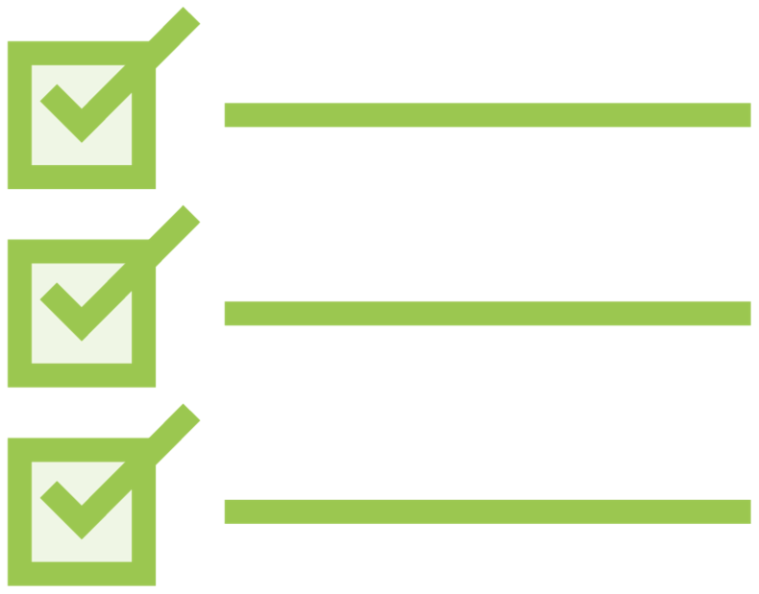
HTTP
Checklist:
Unsubscribing
Store the subscription in a variable
this.sub = this.ps.getProducts().subscribe(…)
Implement the OnDestroy lifecycle hook
export class PLComponent implements OnInit, OnDestroy
Use the subscription variable to unsubscribe
ngOnDestroy(): void { this.sub.unsubscribe();
}

